Slide 1
The Job Search
Chapter: 16

Slide 2
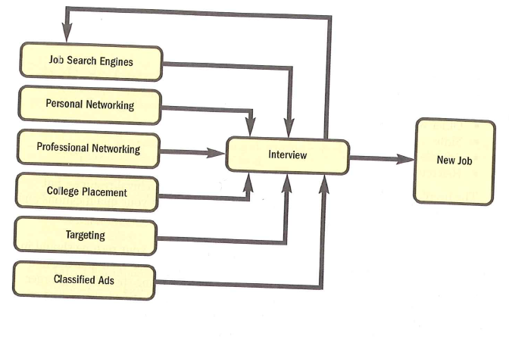
The Job Search Cycle

Slide 3

Responsibilities of a Job Applicant
Preparing for the Interview
Writing a cover letter
Include a resume
The Interview

Slide 4
Situational Knowledge Where/when the interview takes place Arrive 10 minutes early! | Mental Preparation Knowledge of company Practice a mock interview
Physical Preparation Get plenty of rest Dress for success | Written Preparation Take extra resumes, references, etc. Make notes Ask questions

Slide 5
Know the Position | Know the Organization
Duties of the position Compensation range Location Work schedules Benefits | Organization’s name Private or public What products or services Key management team
Where to find organization’s information: Organization’s website Search engines like Google College placement office Networking Library and newspaper archives

Slide 6
Do your homework on the organization: Learn about the company’s services, products, ownership, and financial health – it shows your interest in that company
Write out answers to the questions you consider likely: it will give you a level of confidence unmatched by candidates who only ponder possible questions that might come their way
Rehearse the interview: You can improve your chances considerably by practicing for job interviews and the best technique for it is role-playing
Be prompt at arriving: If you are late for the interview, the interviewer will conclude that you are likely to be late for work. Give yourself extra time in travel to cover any possible traffic problems.
Maintain eye contact while you speak: Be alert, look at the interviewer, and listen actively. Company representatives are likely to consider eye contact and postures as clues to your self-confidence.

Slide 7
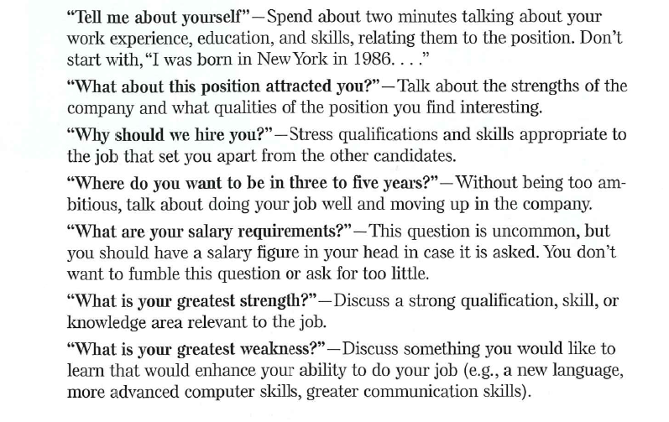

Slide 8
Dress appropriately: You want to make a good impression, so it is important that you look neat, clean and appropriate.
Take an assertive approach: Be positive, direct, and calm. Use every question as a springboard to show your capabilities and interest, rather than waiting for point-blank questions about your qualifications.
Although you do not want to sound too “pushy”, you would take the right opportunities to sell yourself and your abilities.
MEN | Women
Collard shirt Dress slacks A tie A jacket | A conservative, formal dress Formal shoes Avoid excessive jewelry

Slide 9
Ask questions about the type of work you will be doing: the interviewer is your chance to find out if you would enjoy working for this company.
Show enthusiasm for the job: If you are not enthusiastic during an interview, the interviewer is likely to reason that you may not be the person for the job.
Do not engage in long discussions on salary: The time to discuss salary is when the job is offered.

Slide 10
Job Correspondence
Resumes and Job Application
Notes:
Most job letters and résumés are still sent through internet.
Your job application, no longer than one page, should be specific about the job you seek and your main selling points.
Then the résumé—one page or two at most—should simply, specifically, and neatly highlight your background.

Slide 11
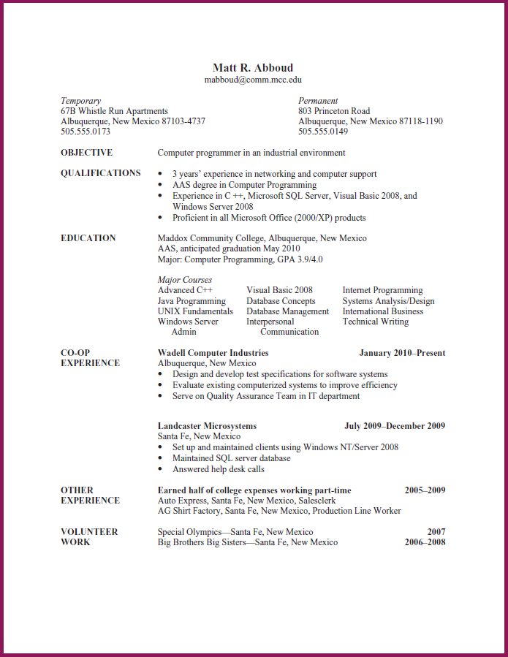

Slide 12
Looking at the resume for ten seconds. What do you remember? In other words, what stands out?
Does the resume look balanced and attractive? Explain.
What information is included in each major section?
How does Matt’s work experience relate to his job objective?
What impression does his earning some of his college expenses make?
What kind of impression does his volunteer work make?
Notes:
A successful, job letter or résumé is the one that gets you an interview. After that, your interpersonal skills help you land the job.

Slide 13
Include a Resume
The resume, a summary of your skills and accomplishments, is your “silent sales representative”
In writing a resume, include the following information:
Contact information: Your name, address and telephone numbers at which you can be reached, your email address
Job Objective: A precise, clear sentence about your specific area of expertise
Example: To use my intellectual abilities, quantitative knowledge, communication skills, and proven leadership ablility creatively to further the organizational mission of a high integrity marketing research organization.
Employment History: paid and nonpaid experiences, beginning with the most recent.be sure to give employment dates, and briefly list important duties and accomplishments.
Education: Schools attended, degree completed
Relevant professional certifications and affiliations: Memberships, offices held
Special skills: Fluency in foreign languages, computer expertise
Interests and activities: only those that are related to your objectives
References: People who know your work, your capabilities, and your character who will vouch for you. Include only a statement that references are available on request.

Slide 14
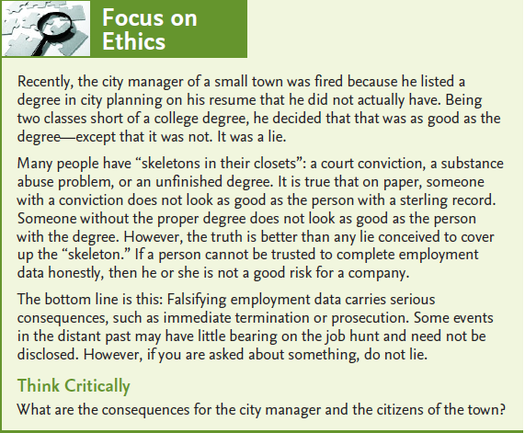

Slide 15
TASK 1: Who I am and How I know This
1. First ask yourself, How do I see myself? List the skills, abilities, knowledge, competencies, and personality characteristics that describe how you see yourself. To generate this list, try completing the sentences: “I am skilled at . . . ,” “I have the ability to . . . ,” “I know things about . . . ,” “I am competent at doing . . . ,” and “One part of my personality is that I am . . . .” List as many characteristics in each category as you can think of. What you have developed is an inventory of your self-concept. Second ask, How do others see me? List the skills, abilities, and so on that describe how you think others see you by completing the sentences: “Other people believe I am skilled at . . . ,” “Other people believe I have the ability to . . . ,” “Other people believe I know things about . . . ,” “Other people believe I am competent at doing . . . ,” and “One part of my personality is that other people believe I am . . . .” Compare your two lists. How are they similar? Where are they different?
2. Under the following headings, fill in information about yourself:
Qualification: Degree, Institute, name
Work Experience: nature of work, name of company, date (year
Professional skills

Slide 16
TASK 2:
Prepare your résumé. If you already have a résumé, revise it to follow this chapter’s guidelines.

